Slide 1
Lecture 31:
Some NMR spectroscopy
Mass spectrometry

Slide 2
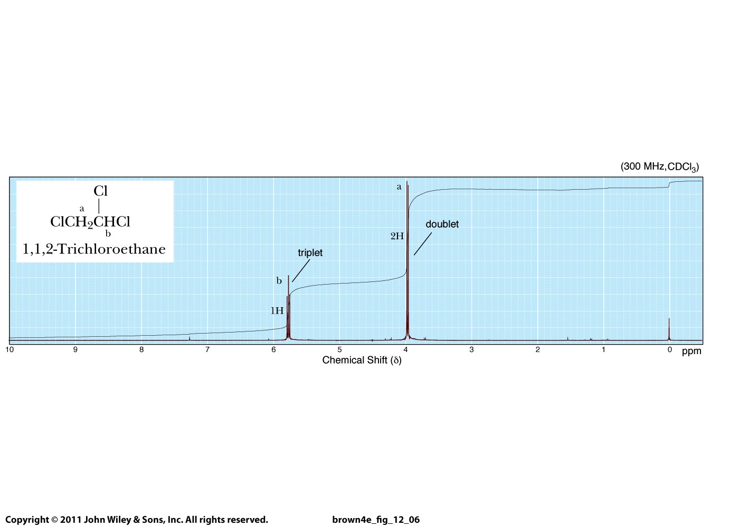

Slide 3
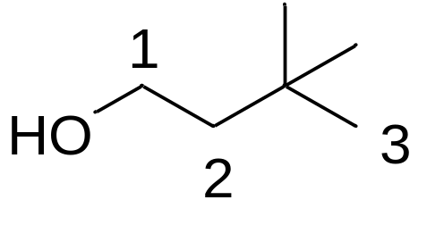
How many signals?

Slide 4
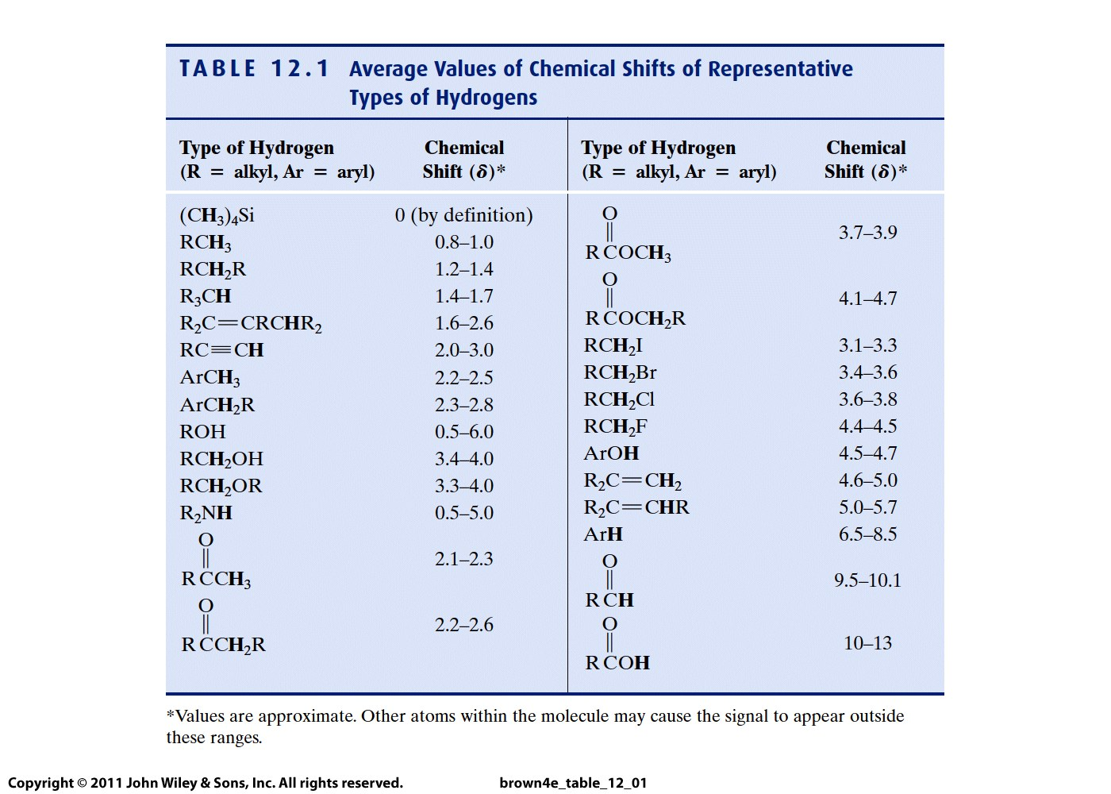
More
highly
shielded
Less
shielded

Slide 5
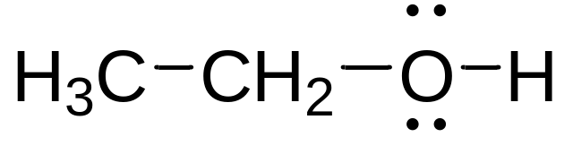
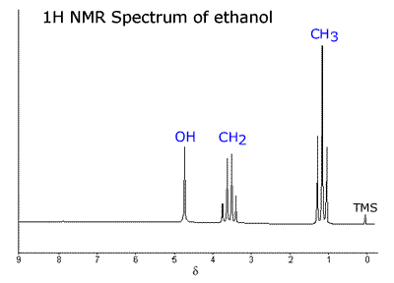
Draw the NMR spectrum for this molecule:
Buddy Question # 108

Slide 6
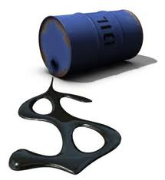

Did you know that mass spectrometry is used to...
Identify environmental pollutants
Characterize crude oil and biofuels
Detect and identify the use of steroids in athletes
Differentiate between healthy and cancerous tissue during
cancer surgery
Identify impurities in drugs and foods
Forensic analysis
This method is great for analysis of mixtures!

Slide 7

alcohol
victim’s
blood
peanut butter

Slide 8
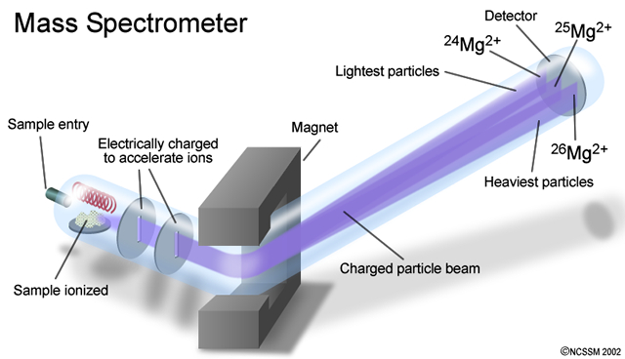
Gas phase

Slide 9
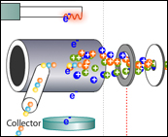
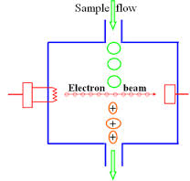
ELECTRON IMPACT
IONIZATION
Gas-phase ions fly into
MASS ANALYZER

Slide 10
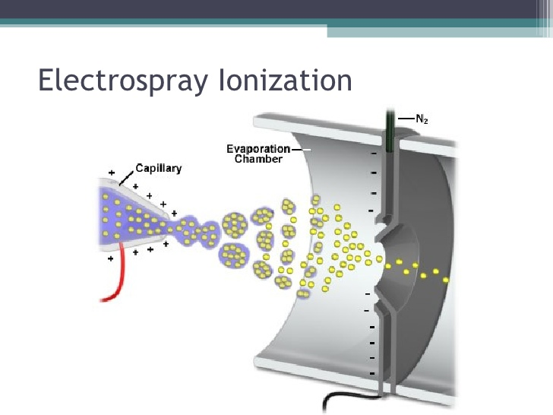

Slide 11
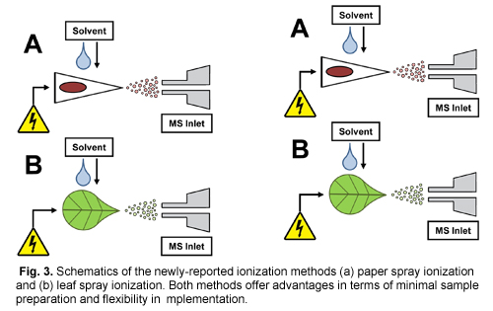

Slide 12
Gas phase

Slide 13
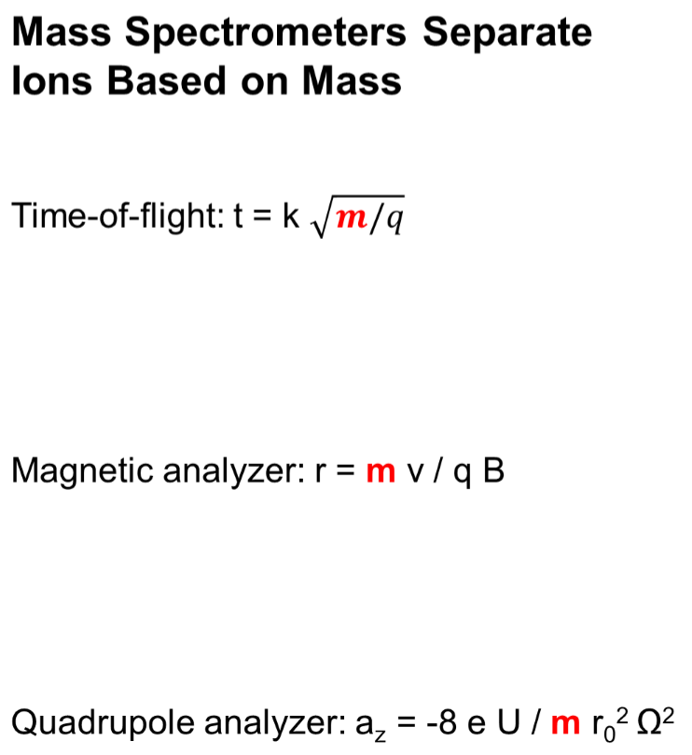
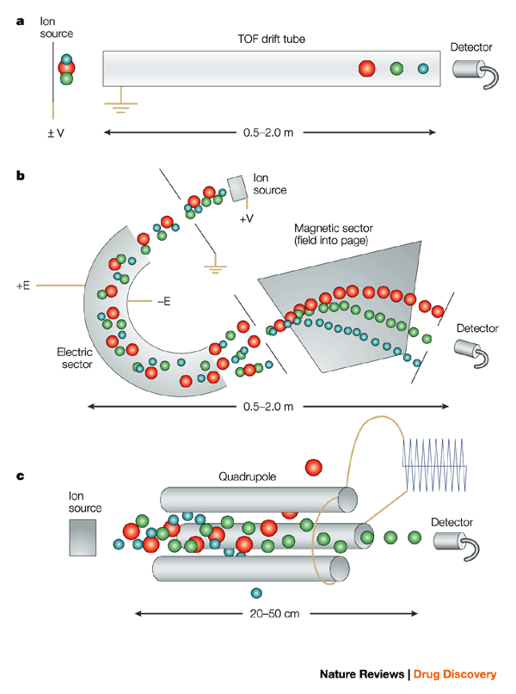
Different methods to separate ions in mass spectrometry
Ionization, Separation of Ions
Based on Mass, Detection
Department of Chemistry – Hilkka Kenttämaa

Slide 14
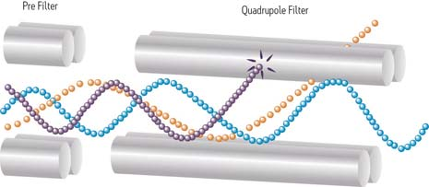
Sorting ions by using rf and dc voltages
large ions
small ions
medium ions

Slide 15
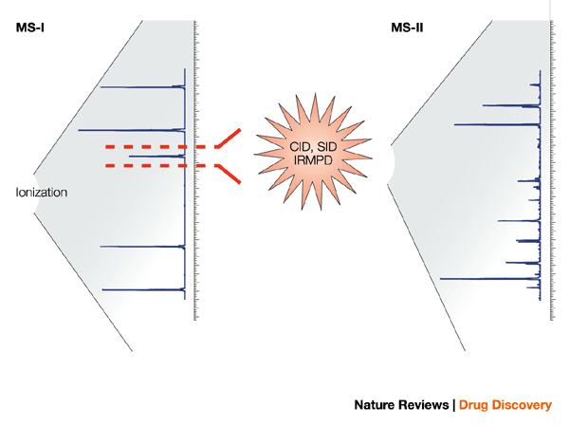
Separation of an ion
Dissociation
Mixture of ionized compounds
from a mixture
Dissociation product ions

Slide 16
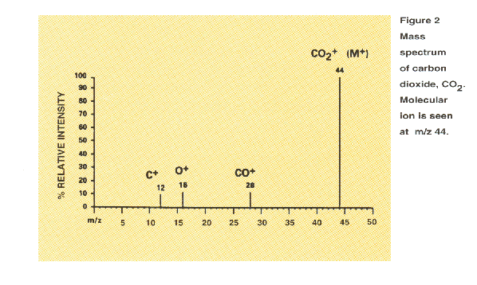
Structural information Molecular weight
Molecular ion
Fragment ions

Slide 17
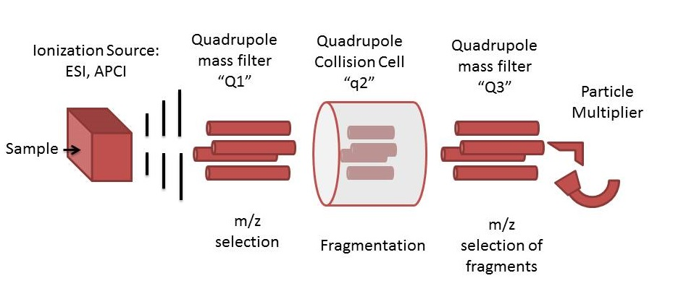

Slide 18
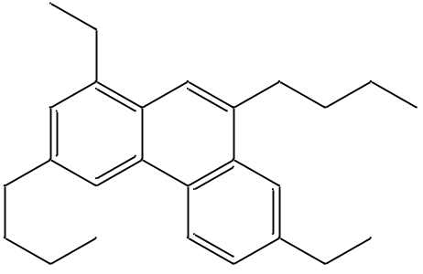
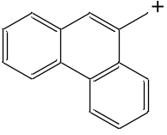
431
457
483
Mass spectrum of Fraction 2 of
Crude Oil (most abundant):
lighter aromatics
100
487
553
418
591
374
633
80
683
743
781
338
841
60
332
881
Relative Abundance
298
947
975
1021
40
294
1069
1127
258
1186
1213
1282
20
245
1317
1415
1449
1493
159
210
0
200
400
600
800
1000
1200
1400
m/z
Structural characterization:
MS/MS CAD spectrum of ion of m/z 346
M^{+●}
303.1987
346.2563
331.2258
100
247.1414
275.1561
289.1667
50
m/z 191
MW 346 Da
0
397.2605
412.3070
Relative Abundance
383.2393
100
271.1470
299.1672
355.2102
369.2274
229.1004
243.1169
50
0
531.3772
546.4550
489.3350
503.3508
100
195.1155
209.1296
223.1419
293.1572
321.1775
349.2009
377.2205
405.2474
433.2793
461.3068
50
0
100
200
300
400
500
m/z

Slide 19
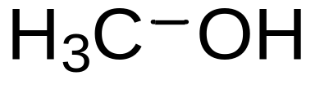
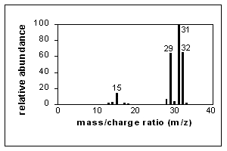

Slide 20
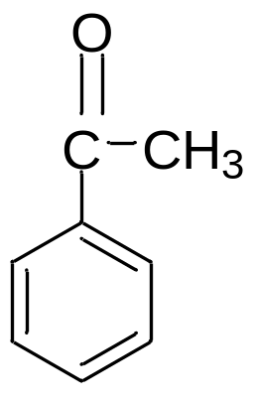
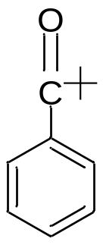
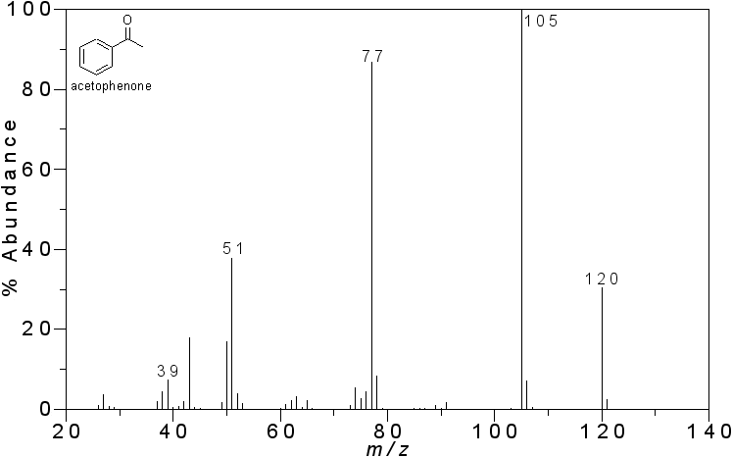
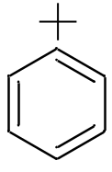
+∙
MW 120
28
CO
15
CH₃

